Slide 1
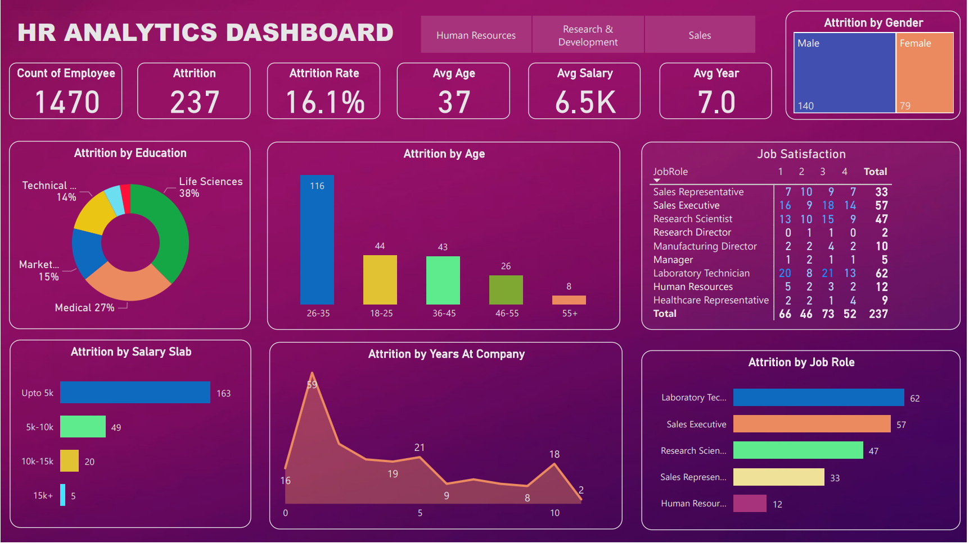

Slide 2
Introduction
The battle with attrition and its implications to productivity and morale
is possibly the biggest headache that any manager will have to face.
Responses to counteract and to decrease attrition often require
the manager to understand the causes and estimate the costs associated
with staff turnover.
Main reasons apart from salary that contribute to employee turnover:
Employees feel the job or workplace is not what they expect,
There is a mismatch between the job and person,
There is too little coaching or training and feedback,
There are too few growth and advancement opportunities,
Employees feel devalued and unrecognize,
Employees feel stress from overwork and have a work/life imbalance, and
There is a loss of trust and confidence in senior leaders.

Slide 3
My task:
Uncover the factors that lead to employee attrition and explore important questions such as
Show a breakdown of distance from by job role and attrition,
Compare average monthly income by education and attrition etc

Slide 4
Business Problem:
Attrition in human resources refers to the gradual loss of employee over time. In general, relatively high attrition is problematic for companies. HR professional often assume a leadership role in designing company compensation programs, work culture and motivation systems that help the organization retain top employee.
OBJECTIVE:
Help an organization to improve employee performance and employee retention (reduce attrition) by creating a HR Analytics Dashboard.

Slide 6
Project Learnings
Identified key factors to reduce attrition
Improved the hiring process
Improved employee experience

Slide 7
THANK YOU

